Slide 1
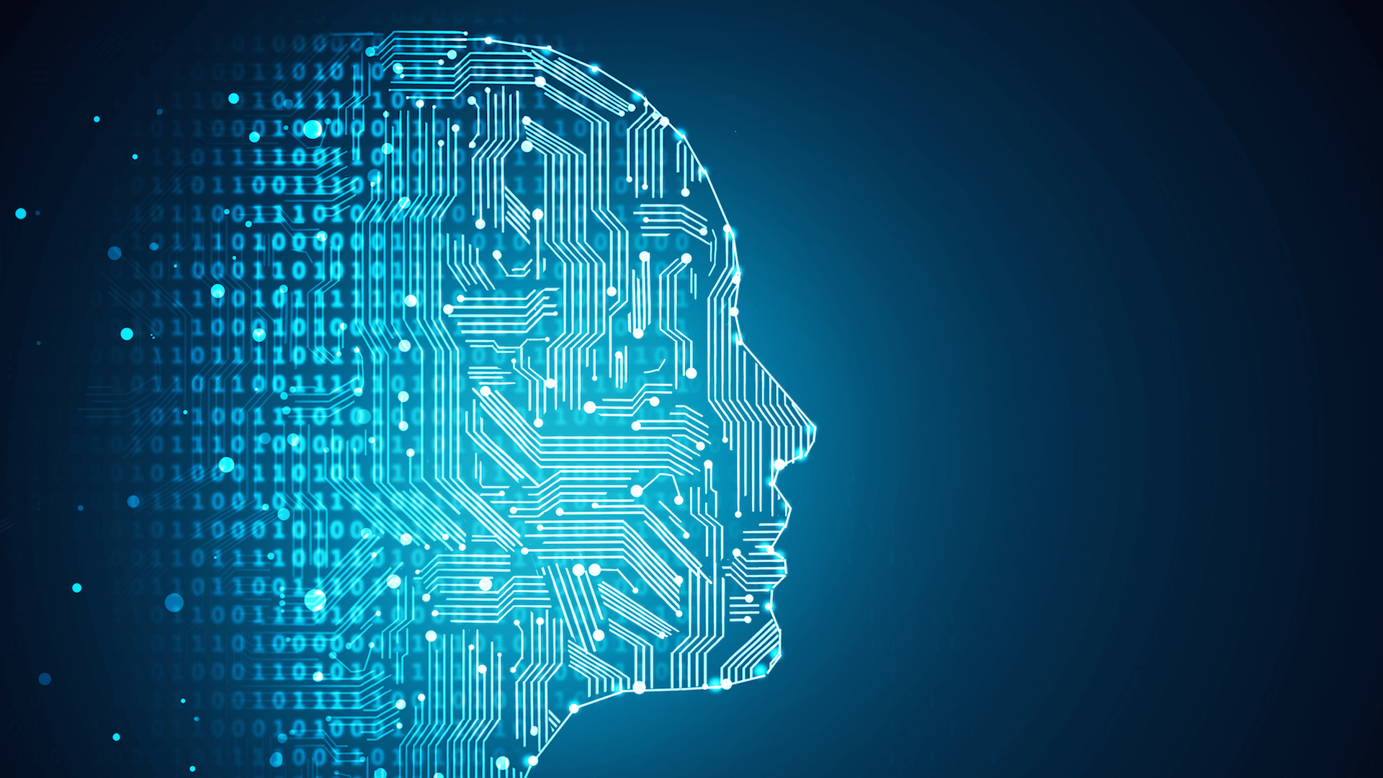
AI & Ethics Project Presentation Facial Recognition
Julius Chan 2082753A

Slide 2
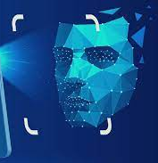
Introduction to Facial Recognition
Face recognition is a technology that can recognize a person just by looking at them. It uses machine learning algorithms to find, capture, store, and analyse facial features so that they can be matched to images of people in a pre-existing database
Biometric security includes facial recognition. Voice recognition, fingerprint recognition, and iris recognition are all examples of biometric software. Although facial recognition is mostly utilized for security and law enforcement, there is growing interest in other applications.

Slide 3
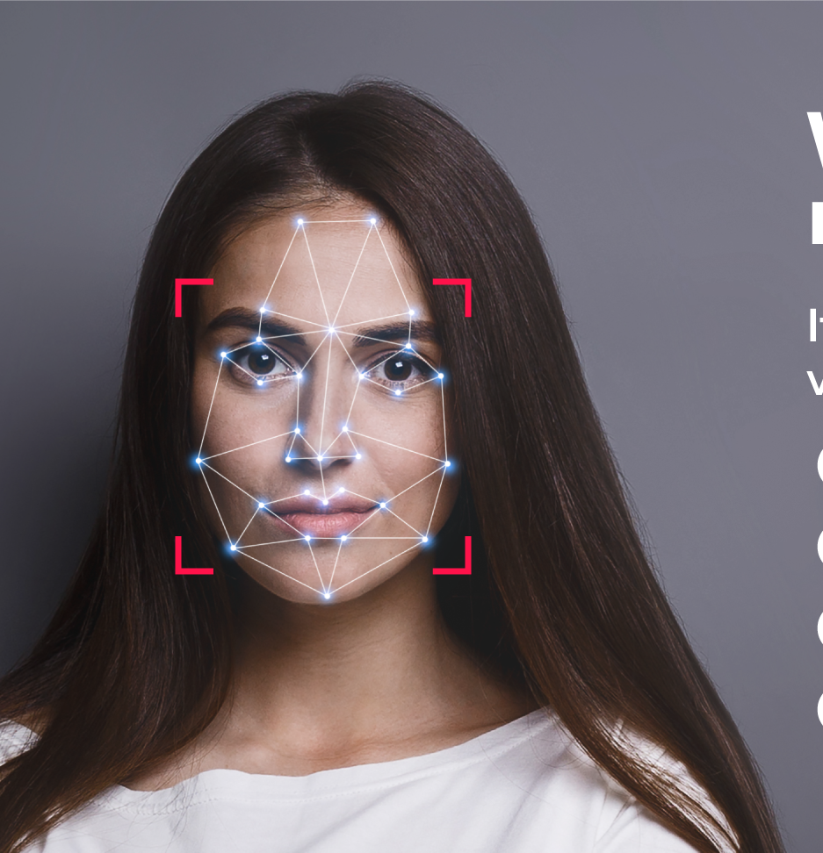
How it works
1. Face detection
The camera detects and locates the image of a face.
2. Face analysis
The image is captured and analysed by the software. The key feature would be the facial landmarks.
3. Converting the image to data
The face captured transforms a face into a set of data based on the subject’s individual facial features.
4. Finding a match
After that, the faceprint is compared to a database of other known faces. A determination is made if the faceprint matches an image in a facial recognition database.

Slide 4
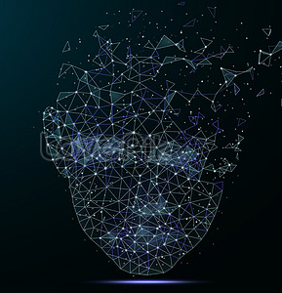
Purposes of Facial Recognition
The technology is used for a variety of purposes such as :
Phone unlocking which use face recognition to unlock the device. The technology offers a way to protect personal data.
Law Enforcement where Police collects mugshots from arrestees and compare them against face recognition databases.
Locating individuals that have gone missing. Missing people and victims of human trafficking can be identified using facial recognition technology. Assuming that a database of missing people is created.
Face recognition is being tested by healthcare staffs to access patient records, speed patient registration, detect emotion and discomfort in patients, and even assist in the identification of certain illnesses.

Slide 5

Potential Ethical Issues
Fooling Face Unlock
One of the major drawbacks of face unlock is the threat to individual privacy and the fear of being fooled by using objects or photos of an individual to unlock the device.
Privacy Violation in Public
People dislike having their faces photographed and stored in a database for unknown purposes in the future.
Discrimination
According to the researchers, facial recognition technologies tend to have false positives. These false positives occur more regularly with people of color, women, children, and the elderly.
Face Recognition in Photos & Social Media
Facebook and other social media sites use the technology to identify and tag people in photos. This facial recognition software recognized people in Facebook photos and suggested that users tag these people in the photos, linking them to the tagged person's profile. Inaccuracy or identity theft may occur. . To commit identity fraud, they can collect personal information from individuals, including imagery and video collected from facial scans and stored in database.
Deepfakes
Deepfake uses a form of synthetic media to turn something that seems authentic. Deepfakes can be used to deceive face recognition, and a data breach can also take a person's facial recognition and use it as a deepfake.

Slide 6
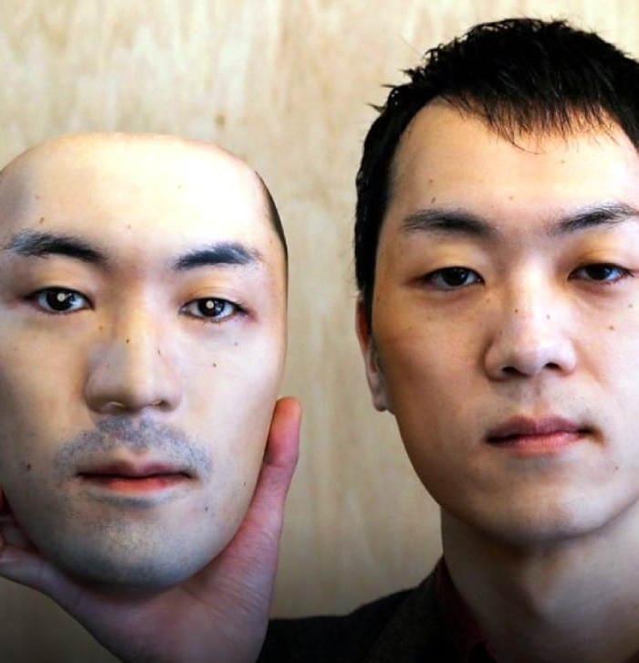
Fooling Face Unlock
Our smartphones, which requires a scan of your face and storage in local memory, are popular device that stores our facial recognition. The next time your phone scans you, it utilizes this information to learn more about your face and open your smartphone. As a result, users are at risk of an individual privacy violation once their facial data are stored.
In most situations, a low-cost phone's facial recognition depends solely on the front-facing camera and some less-than-advanced algorithms, with the occasional use of a flash to improve photo quality.
Certain front facing cameras can be fooled by photos that are printed on paper or shown on a screen. Even betters one can be fooled using a 3-D printed mask. Once fooled, hackers can use device to steal personal information or assets.
Subject holding a 3-D Printed Mask
Notes:
In one of the studies, cybersecurity experts attempts to trick Face ID with 3D printed Masks. The new mask is constructed of stone powder with 2D infrared images of eyes glued over it, according to the research firm. As a result, the mask imitates a human face with eyes for Face ID.
From there, the individual is successfully able to unlock the iPhone X using just the 3D printed mask, even with attention detection enabled. This is because Face ID mistakenly recognizes the infrared images as real eyes.
Experts recommended that “very important people” such as national leaders be wary of using Face ID. Now, the research firm says that “causal users” should also be cautious as it does not view Face ID as “secure enough to be used in business transactions.”
Source : https://9to5mac.com/2017/11/27/face-id-tricked-with-mask-video/

Slide 7
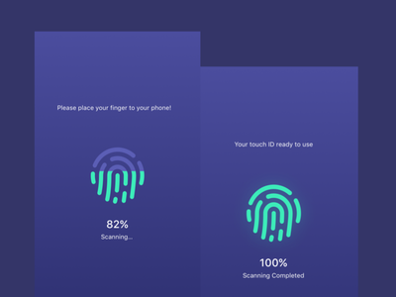
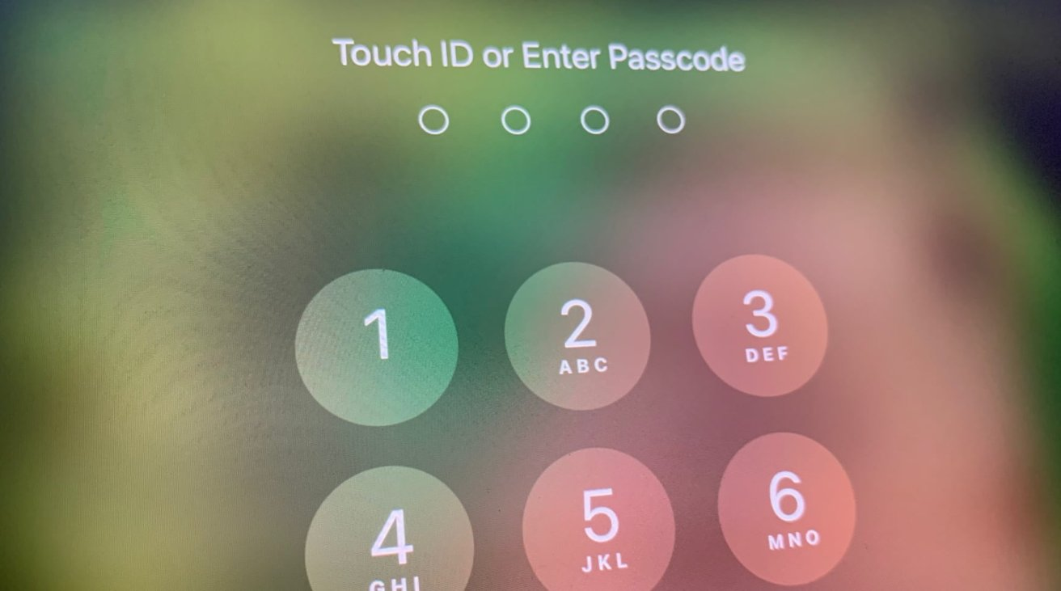
Proposed Solution (Fooling Face Unlock)
Due to the widespread use of face unlocking without proper hardware, modern phones will have a poorer overall level of security. Fortunately, it isn't the default authentication for the time being as there are different types of authentication methods.
Individuals may want to use authentication methods such as passcode or fingerprint login. A passcode is much far more secure if users keep it a secret compared to face recognition as it uses the user’s biometric data. Fingerprint login are not exactly safer than face recognition, but it continually learns the fingerprint and gets better at recognition over time.
If the person wishes to use face recognition as their authentication method, they should read the phone's face recognition method's details before enabling it. It must be extremely secure in order to avoid falling for photographs or masks, as well as leaking your data.
Fingerprint Login
Passcode Login
Notes:
Security researchers mostly agree that Face ID is less secure than a fingerprint. That’s partly because it maps your facial features, and often, facial features are not unique. There are plenty of stories about family members being able to unlock devices with face ID– even if they have different colored eyes and hair.
Source : https://phoenixcellular.com/news/face-id-vs-fingerprint/

Slide 8
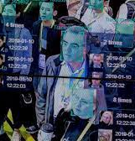
Privacy Violation
Facial recognition may violate the rights to privacy. Public places have been flooded with surveillance camera networks. When combined, these systems can determine where we've been, who we've been with, and what we've been doing. All of this is predicated on a single, unchangeable marker which is our own faces.
Face recognition in a surveillance situation is promoted as an attempt to increase security which plainly comes at a cost of a potential breach of privacy where individuals feel uncomfortable due to the lack of permission of collection on their facial recognition data.
Face recognition privacy concerns also comes from improper data storage, which exposes face ID to potential security threats. Face recognition data is still stored on local servers in many organizations. Persistent hackers are more likely to gain access through this route unless you have a team of IT security experts on hand to maintain network security 24/7.
Example of how surveillance camera networks works
Notes:
It has been claimed that Facial recognition technology is now socially acceptable because people are accustomed to having it on their smart phones. The important thing to take note of is that they chose to do so, and it is to protect their own assets and personal information.

Slide 9
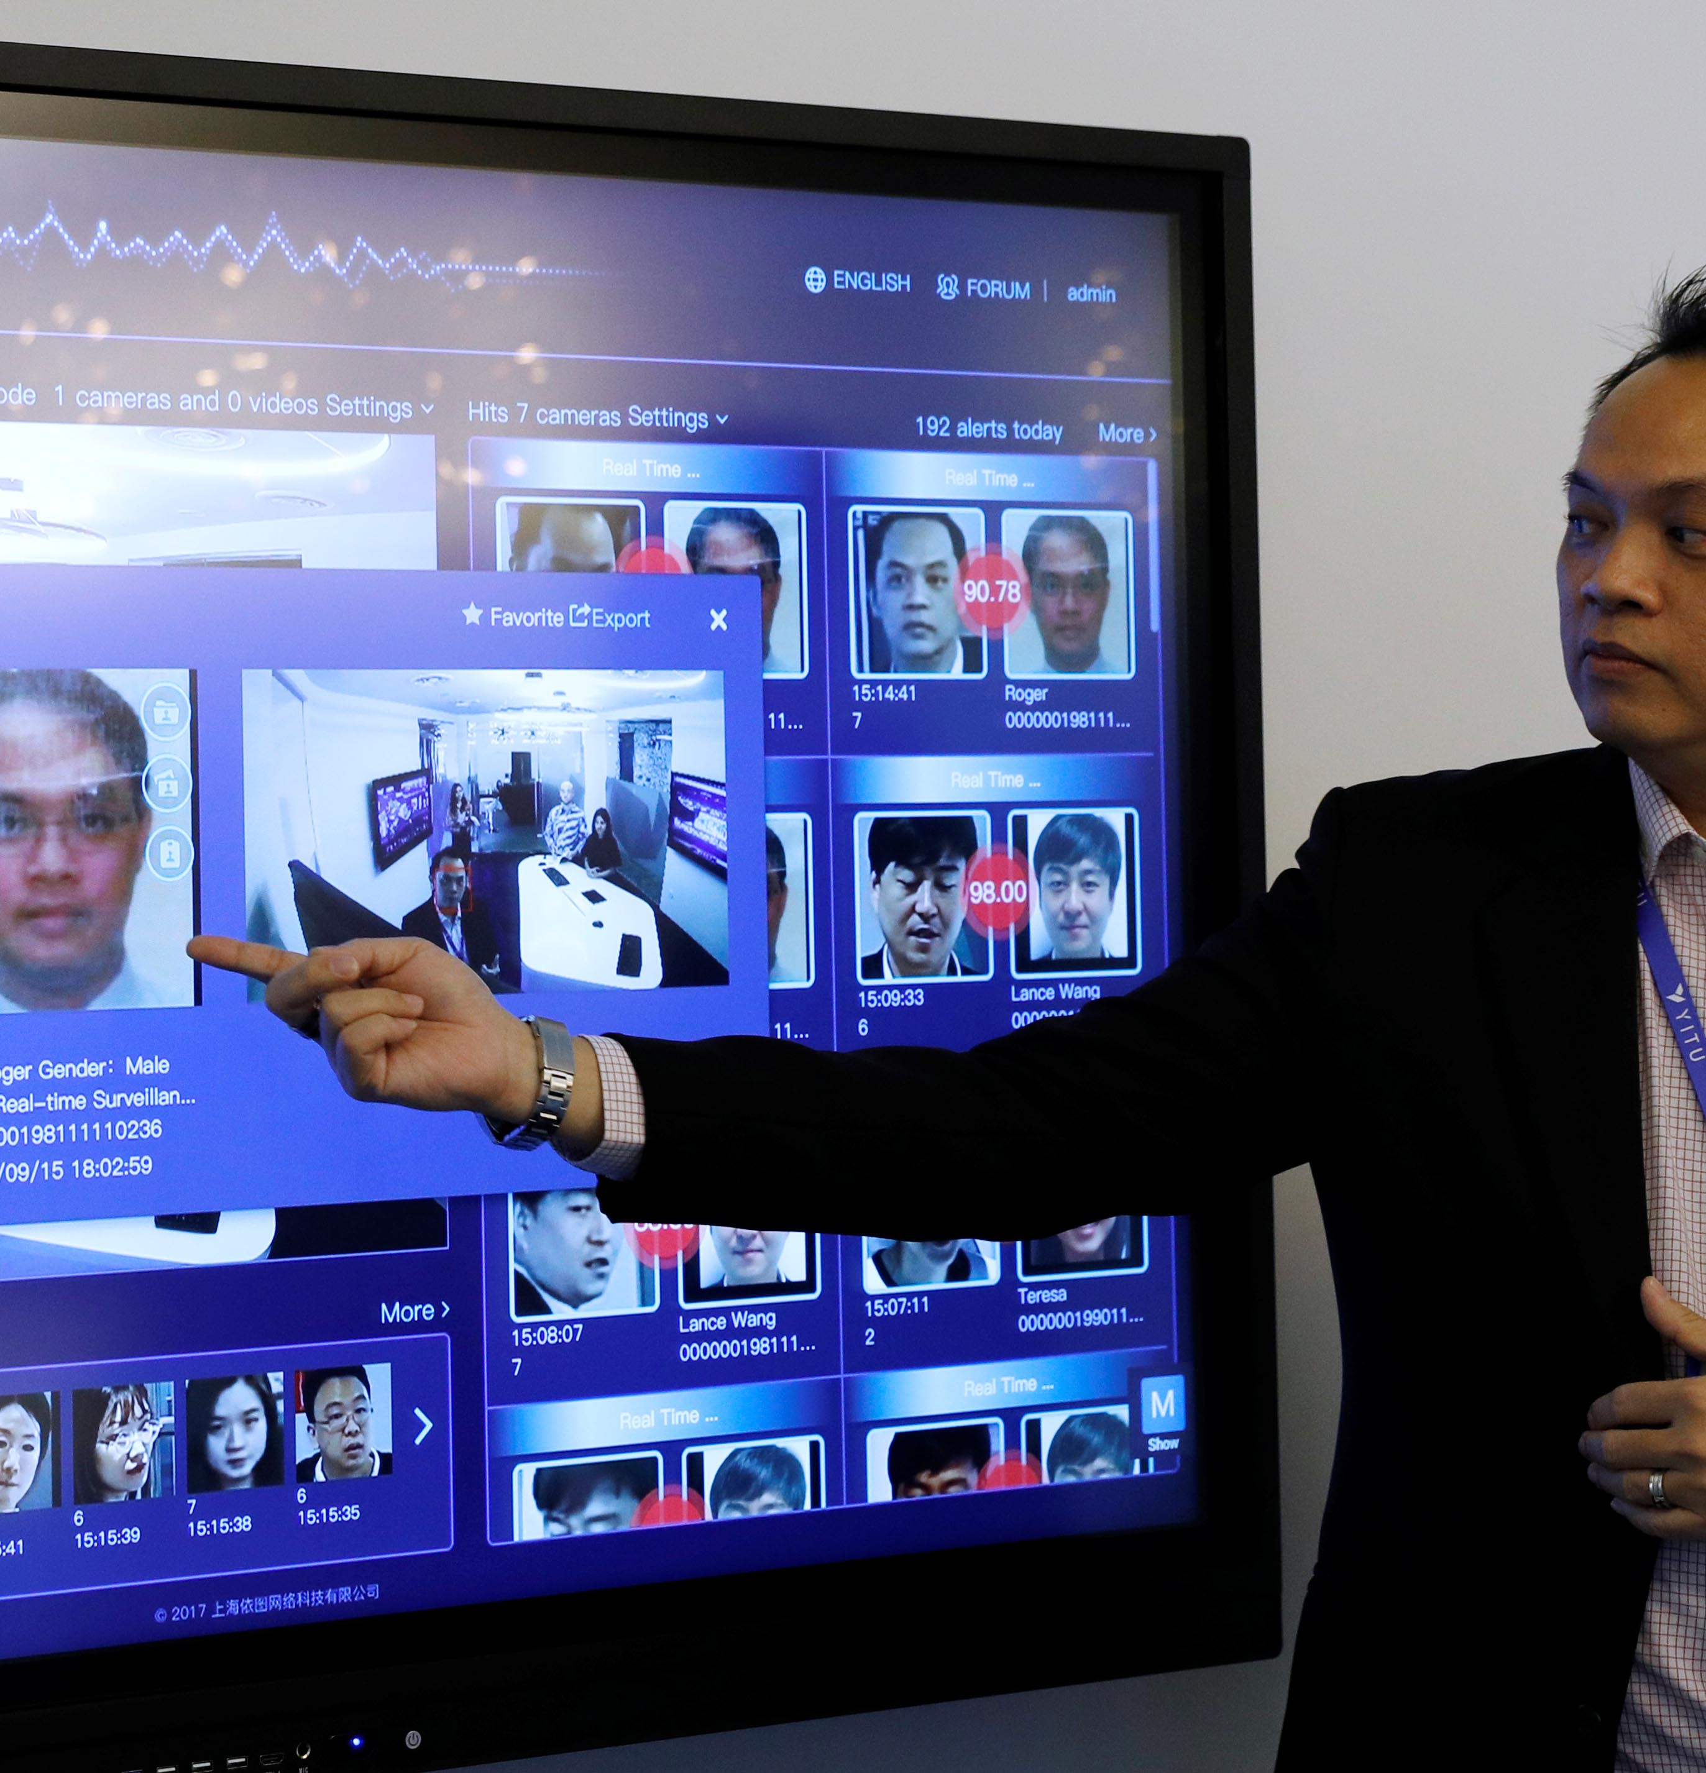
Proposed Solution (Privacy Violation)
There is no actual solution to such issue. Many individuals has voiced their concerns regarding their violation of privacy. Considering these threats, various governments and organizations throughout the world have begun enforcing more rules and regulations to ensure that such technology are not misused.
Rather than being used in a variety of public places, surveillance camera with facial recognition technology should be used in high-security facilities with given notice such as banks, restricted areas, airports or places with a high crime rate. This would make it easier for people to comprehend and feel protected, as well as aid authorities in locating criminals spotted by the face recognition technology.
A law enforcer making use of facial recognition to identify suspects
Notes:
As facial recognition becomes more common as a means of keeping us safe, we'll have to manage a difficult combination of norms, rules, regulations, and ethics as individuals demand trust .While many organizations and professionals are against such technology, others are in favor of it.

Slide 10
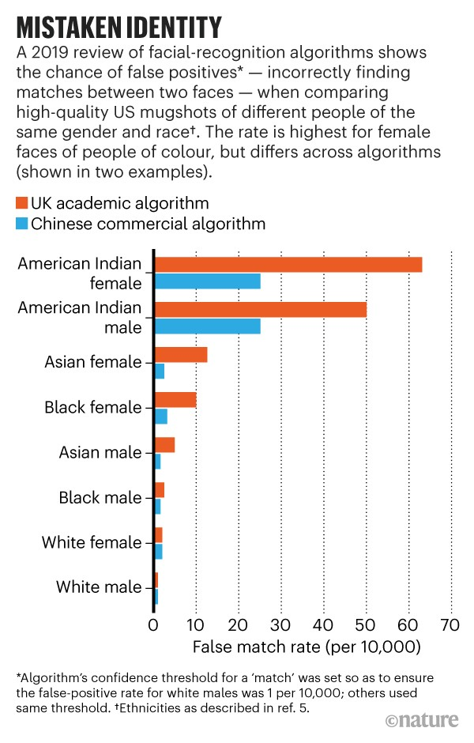
Discrimination
One of the key issues to facial recognition is that false positives tend to occur to people of color and facial features which leads to racial discrimination.
In one of the research, the inaccuracy revealed is due to the way these tools are developed. After being given millions of photos of human faces, algorithms "learn" to recognize a face. If the faces used to train the algorithm are mostly men of the same skin color, the system will struggle to recognize anyone who doesn't fit which leads to bias.
This could cause issues in a variety of ways. The wrong individual being able to unlock a facial recognition device. People of color are more likely to be arrested for minor offenses, resulting in their mugshot being included to the face recognition database. Face recognition software could lead to them getting arrested more frequently as a result of this.
A 2019 Graph showing False Match Rate on faces of different races
Notes:
In one of the studies, Asians and African Americans are 100 times more likely than white men to be mistaken, with Native Americans seeing the highest rates of false identification.
Face recognition technology was utilized by the South Wales Police at the 2018 Champions League Final to try to discover known criminals. They then revealed that 2,297 of the 2,470 facial matches were incorrect. That's a 92 percent of false positives.
"If you're a white guy," says New York Times journalist Steve Lohr, "facial recognition is correct." If you're not, it gets a lot less accurate. Non-whites, women, and children are naturally discriminated against in the system, with non-white women making up to 35% of the errors.
Source: https://www.engadget.com/2018-05-06-police-face-recognition-misidentified-2300-as-criminals.html

Slide 11
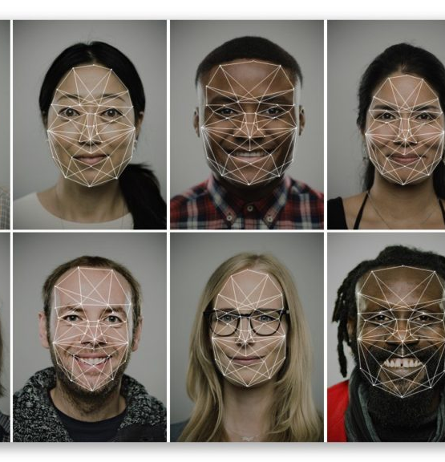
Proposed Solution (Discrimination)
Before these technologies can effectively aid with security and monitoring, the underlying artificial intelligence (AI) algorithms must be improved to ensure that the program recognizes faces without any bias and the risk assessment of such system must always be in check.
Facial recognition may change in the future as the technology scans and discovers a wider range of faces. Audits should be performed to evaluate the risks of the system and to improve the development team's study into 'deep learning’ techniques.
Algorithm bias can be reduced with “model training" on exposure to a large representative database of individuals.
Facial Recognition Algorithm showing a wider range of faces
Notes:
One of a major researcher's tasks required her to engage with a computer vision-equipped robot, but the robot was unable to "see" her. She later discovered that unless she put on a white mask, a computer camera would not recognize her face.
Source: https://www.cbsnews.com/news/facial-recognition-systems-racism-protests-police-bias/

Slide 12
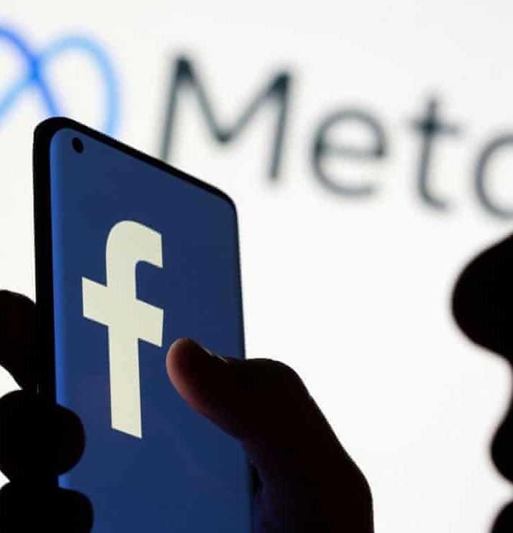
Recognition system in Photos & Social Media
In social media sites like Facebook, when users agreed to use facial recognition, Facebook scanned their "faceprint" and used it to find photographs and videos of them on the platform, with the option of tagging them. According to consumers, the option was turned on by default and was without their consent leading to invasion of privacy.
Facial recognition technology isn’t accurate, it's possible that people will be misidentified and tagged in images. Particularly on social networking platforms, where stalkers could use reverse image searches on a photograph taken in a public place to learn more about their victims and figure out who they are and where they reside.
Identity fraud could be committed by criminals who have gathered enough personal information & facial data from individuals in photos on social media. This could have a major impact on the subject’s personal life as criminals may impersonate their profiles.
Image of the Facebook logo but now known as Meta
Notes:
In Dec 2017, Facebook announced changes to how it asks users for permission to collect their personal data — including facial recognition data — to comply with strict new European privacy rules.. Facebook says it has made it easy for users to understand their choices and to turn off the facial recognition feature, but critics say the process is rigged to nudge them not to. It's on by default; users need to go into settings to turn it off.
Source: https://www.vox.com/future-perfect/2019/9/4/20849307/facebook-facial-recognition-privacy-zuckerberg
Source: https://www.usatoday.com/story/tech/news/2018/04/19/facebook-growing-use-facial-recognition-raises-privacy-concerns/526937002/

Slide 13
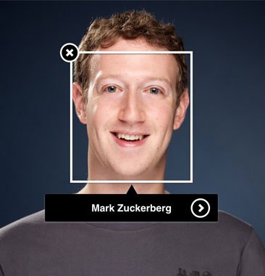
Proposed Solution (Face Recognition in Photos & Social Media)
Companies and applications that want to use facial technology should always follow the rules of ethics and the law. Make sure users and consumers are aware that if the app uses face recognition technology. As a result, others will be aware that such technologies & policy exist. It also allows visitors and users of the technology to determine whether they want to keep doing so.
Actively seeking consent & compliance from the consumers gives protection to the business from breaking the law while also giving them control over their privacy and the ability to make their own decisions. It all boils down to the users' decision, and they must be willing to face the risk of such technology.
While facial recognition technology is a useful tool for confirming identity, it requires privacy controls to allow people to regulate how their faces are used. There are many concerns regarding the role of facial recognition technology in society, and that it should be limited to personal use, such as face Id on devices.
CEO of Facebook : Mark Zuckerberg
Notes:
Between April 2018 and September 2019, South Korea ordered Facebook to pay 6.46 billion won (US$5.5 million) for developing and storing facial recognition templates of 200,000 local users without their consent.
Facebook has been ordered to destroy or get consent for facial data collected without consent, as well as to stop processing identifying numbers without a legal basis. It was also required to erase acquired data and reveal items connected to personal data migration to other countries.
In Nov 2021. Facebook plans to shut down its decade-old facial recognition system, wiping the face scan data of over one billion users and effectively ending a feature that has sparked privacy concerns, government probes, a class-action lawsuit, and regulatory issues.
Facebook has faced widespread criticism over its attitude towards user privacy and safety, after numerous breach of data.
Source: https://www.theregister.com/2021/08/26/facebook_fined_by_south_korea/

Slide 14
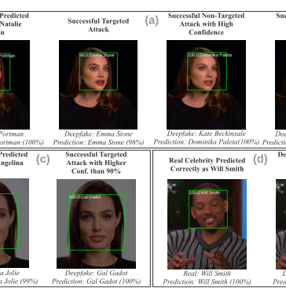
Deepfakes
Deepfakes are created by photos of the same person's face from various angles and emotions are required to make one that is convincing. Deepfake generating methods pose a higher threat to recognition systems than others.
Anyone with photographs of a victim may generate a convincing deepfake using open-source tools, and a new study reveals that deepfake-generating techniques have advanced to the point that they can reliably deceive professional facial recognition algorithms.
Another concern that could arise is hackers exploiting a subject's face recognition data and biometrics to create a deepfake which leads to complications.
A deepfake platform analysing and predicting the results of targeted attacks
Notes:
The current deepfake technology was put to the test by researchers at South Korea. To see how well Amazon and Microsoft APIs perform, they employed open-source and widely known deepfake video creation software. The researchers were able to trick the algorithm 78 percent of the time utilizing deepfakes on Microsoft Services. Amazon fared somewhat better, with 68 percent of submitted faces proving to be real.
Source: https://www.makeuseof.com/deepfake-fool-facial-recognition/

Slide 15
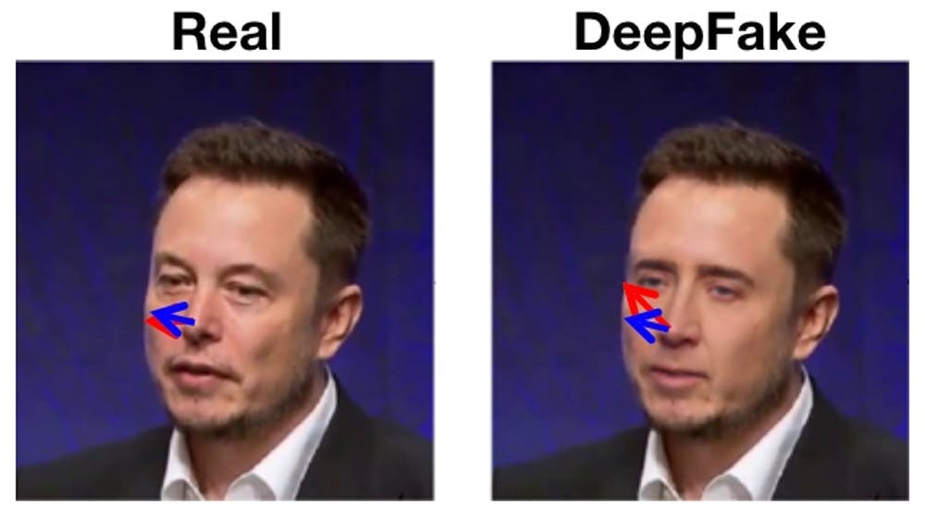
Proposed Solution (Deep Fakes)
Many studies are trying to figure out how to spot deepfakes. The technology solution is to use the same types of AI that are used to create deepfakes to detect them. Deepfake detectors act in a similar manner to deepfakes. The detectors are pieces of software that have been trained to detect deepfake films using machine learning models.
Individuals who are affected by deepfakes should contact the police to report it and let authorities handle it, as creation or distributing deepfake content is a serious crime. On the bright side, many companies such as Facebook & Google are hosting challenges that detects deepfakes. The challenge's purpose is to encourage researchers across the world to develop new tools that can detect deepfakes and altered material. Participants in the challenge must submit their code for testing.
Example of a real & deepfake image of Tesla’s CEO Elon Musk
Notes:
According to Deeptrace, the number of deepfakes online increased by 330 percent in under a year. Not to mention, the software and algorithms deepfake makers use are becoming stronger and more readily available and accessible.
Source: https://www.makeuseof.com/deepfake-fool-facial-recognition/

Slide 16
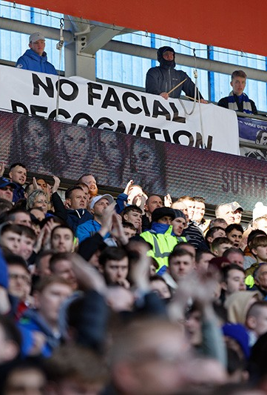
Conclusion
Face recognition, like any other technology, has potential drawbacks, such as threats to privacy, violations of rights and personal freedoms, data theft, and other crimes.
One of the most controversial and complicated policy areas currently in play is face recognition. Face recognition has been shown to be flawed and inaccurate, frequently misidentifying and affecting people of colour.
Facial recognition, when used correctly, can be a useful & convenient tool. However, trying to protect yourself from the potential threats is still a good idea. If you're given the option of having your image collected for facial recognition, think about whether it's worth it.

Slide 17
References
https://www.forbes.com/sites/fernandezelizabeth/2020/08/13/facial-recognition-violates-human-rights-court-rules/?sh=6a61f22d5d44
https://www.kaspersky.com/resource-center/definitions/what-is-facial-recognition
https://www.eff.org/deeplinks/2021/10/resisting-menace-face-recognition
https://phoenixcellular.com/news/face-id-vs-fingerprint/
https://www.kaspersky.com/blog/face-unlock-insecurity/21618/
https://towardsdatascience.com/how-ethical-is-facial-recognition-technology-8104db2cb81b
https://www.wsj.com/articles/faces-are-the-next-target-for-fraudsters-11625662828
https://www.nature.com/articles/d41586-020-03186-4
https://www.cbsnews.com/news/facial-recognition-systems-racism-protests-police-bias/

